Slide 1
AUTOMOBILE DASHBOARD ANALYSIS
Project Summary Presentation

Slide 2
Introduction The Automobile Dashboard Analysis project focuses on evaluating car sales data to derive insights related to brand performance, regional sales, profitability, and customer behavior. The dataset includes detailed fields like InvoiceDate, Make, Country, SalePrice, CostPrice, Discounts, Delivery Charges, Spare Parts, and Labor Costs, enabling deep financial and operational analysis across countries, years, and vehicle types Methodologies Data Extraction & Cleaning: Handled missing values, standardized formats, and removed duplicates using Power Query. Data Transformation: Added calculated columns (e.g., total cost, profit margin) and split dates into year/month for better time series analysis. Data Modeling: Built relationships and hierarchies in Power BI for easier slicing (Make → Model → Country). DAX Measures: Total Sales / Profit YOY Growth, Cumulative Sales, Moving Averages Customer Count, Sales per Region/Category

Slide 3
Requirement Analysis Tasks Covered: Task 1: DAX-based performance measures (e.g., Top 5 products, Avg. sales/customer, YTD, 12-month rolling sales). Task 2: Data shaping (e.g., filter by Make, remove columns, pivot on Color, merge tables). Task 3: Visualization strategy (e.g., bar, line, pie, KPI, map, waterfall, funnel, combo, matrix visuals). Core goal: Transform raw automobile sales data into a strategic decision-making dashboard.. Approaches Time-Based Trends: YOY & MOM trends using InvoiceDate & ReportingYear. Profitability: Derived profit using SalesPrice-TotalCost Category Performance: VehicleType & Make-based breakdowns Geographical Analysis: Map & Heatmaps for regional comparison. Customer-Level Insights: Sales by individual client, highest-paying clients, and their vehicle preferences.

Slide 4
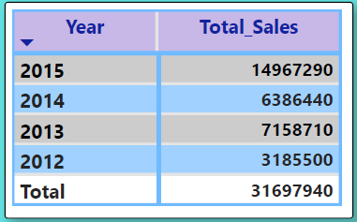
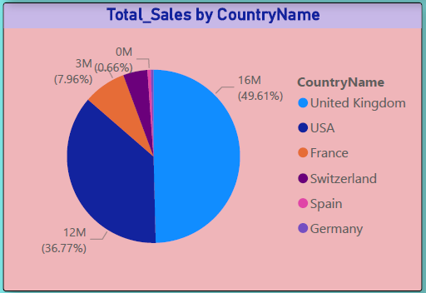
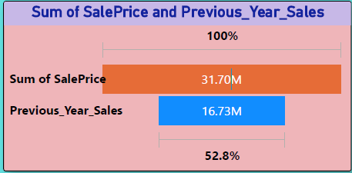
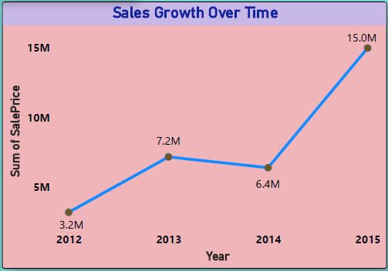
Visualizations (From Dashboard) Year Wise Sales and Total Sales Total Sales by Country Name Sum of Sales and Previous Year Sales Sales Growth Over Time

Slide 5
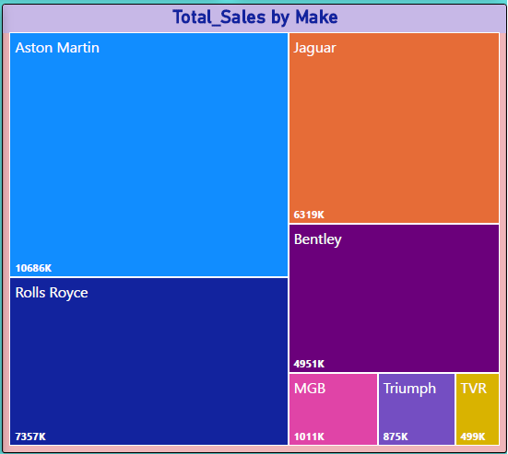
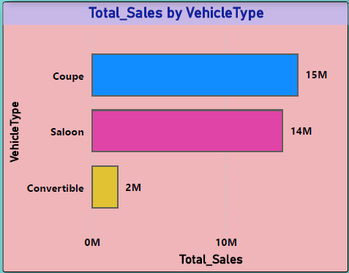
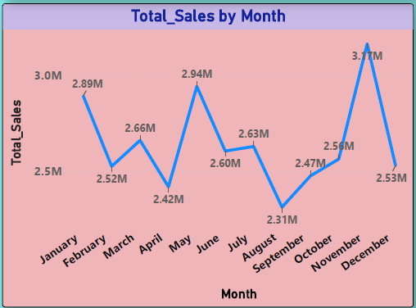
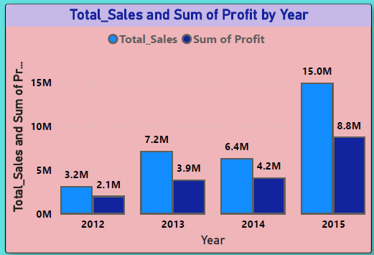
Visualizations (From Dashboard) Top Sellers Brands Total Sales by Vehicle Type Sales peaked Month Year Wise Profit and Sales

Slide 6
Key Findings Top Brands: Brands like Jaguar, Mercedes, and BMW emerged as top sellers across high-sale countries. Profitable Markets: The UK and Germany showed higher average profits due to low delivery/labor costs. Vehicle Preferences: Coupes and Convertibles were preferred vehicle types in luxury segments. Trend Insight: Sales peaked in Nov months (identified via highest sales month DAX), revealing seasonal patterns. Customer Behavior: A small segment of clients accounted for a majority of the revenue. Key Insights Findings Pricing Strategy: Significant discounts didn’t always translate to higher profits Geography-Driven Sales: Regions with low logistics costs had better margins. Inventory Guidance: Makes/Models with declining sales trends could be deprioritized. High-Value Clients: Can be targeted for loyalty programs or upselling.

Slide 7
Actionable Recommendations Dynamic Discounting: Use discount-profit relationship to adjust offers by Make/Model. Focus on High-Performers: Allocate inventory to high-performing countries and brands. Client Targeting: Segment high-value clients for personalized marketing. Optimize Operational Costs: Reassess labor and delivery charges in low-profit regions. Conclusion The analysis successfully identified major sales drivers, optimized discount strategies, and exposed geographic and seasonal patterns. With clear visibility into sales and profitability metrics, strategic decision-making around pricing, marketing, and inventory becomes data-backed and targeted.

